Slide 1
Aggressive Mustard Rebellion
By:
Michael Kuzminsky, David Hunter, Ross Bunker, Hunter Lang and Matt Bailey

Slide 2
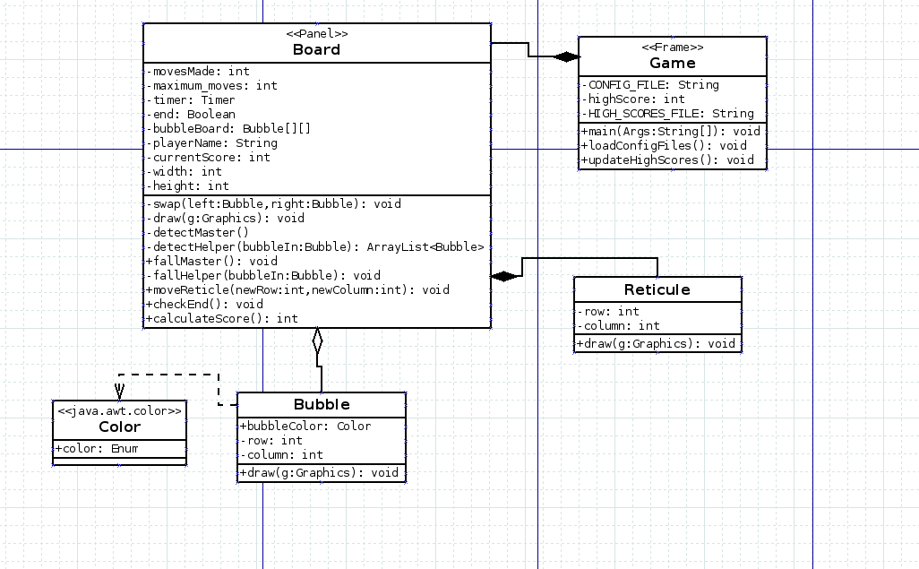
UML

